Slide 1
Category review: Chips
Retail Analytics

Slide 2
Executive summary
01
Task 1
Young singles/couples and Mainstream shoppers are the priority segment for chips: they drive the highest brand-driven spend, but visit less often than other segments and pay a measurable premium (+9%, statistically significant) versus Budget/Premium shoppers in the same life stage. Older families and retirees drive volume through purchase frequency rather than price.
02
Task 2
The trial layout produced a significant, immediate sales and traffic uplift across all three trial stores in the first month, but only one of the three stores sustained the effect for the full trial period. Recommend a wider pilot with close monitoring rather than an immediate full rollout.

Slide 3
01
Category

Slide 4
Category Overview
Chips revenue is split between two very different shoppers: frequent family/retiree buyers, and high-margin young Mainstream buyers who pay more per visit.

Slide 5
Does Affluence Drive Spend?
No life stage segment has Premium shoppers as its top revenue contributor; Mainstream and Budget dominate sales across every segment.
Among Young and Midage Singles/Couples specifically, Mainstream shoppers pay $0.33 more per unit (+9%) than Budget/Premium shoppers in the same life stage (p < 2.2e-16, 95% CI: $0.316–$0.351).
This suggests the premium is driven by life stage and mainstream positioning, not by the income tier the PREMIUM_CUSTOMER label implies.

Slide 6
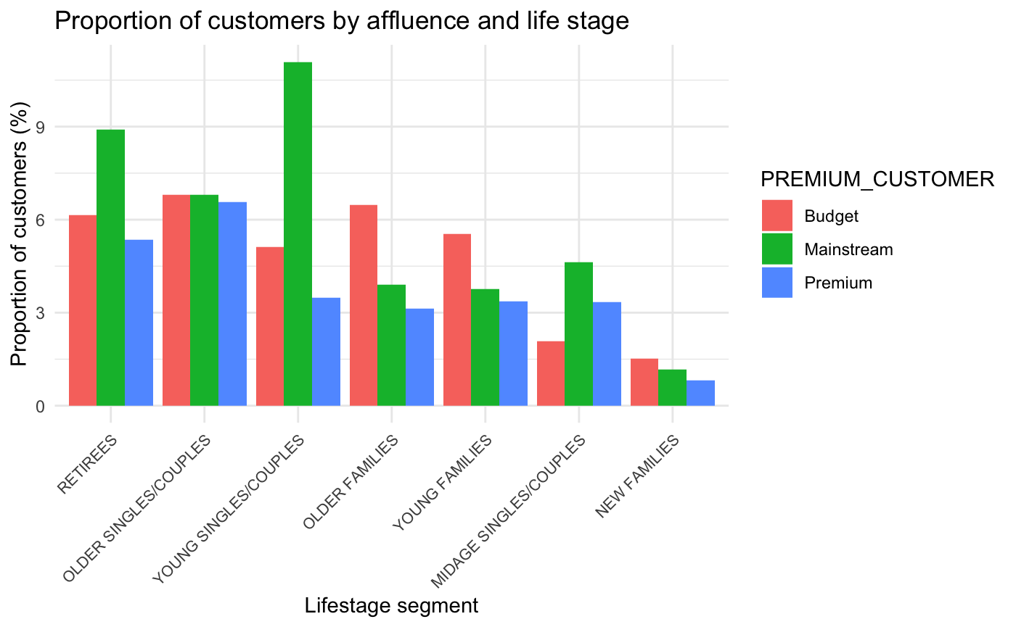
Customer Mix by Life Stage & Affluence
Young Singles/Couples Mainstream is the single largest customer segment in the entire base, at roughly 11% of all customers, well ahead of every other life stage × affluence combination.
Mainstream and Budget dominate customer volume across most life stages, while Premium is consistently the smallest share within each group, except among Older Singles/Couples, where all three segments are nearly balanced (6.6–6.8% each).

Slide 7
02
Trial store performance

Slide 8
Control store selection
Control stores were selected by matching each trial store to the candidate with the most similar pre-trial performance (July 2018–January 2019) across three drivers: total sales, customer count, and purchase frequency, combined using a correlation and magnitude-distance score.
This identified stores 84, 138, and 201 as controls for trial stores 77, 86, and 88 respectively.

Slide 9
Trial Performance: Did It Work?
All three trial stores recorded a statistically significant uplift in sales and traffic in February, the first trial month (+33%, +31%, and +17% vs. control respectively).
Only store 77 sustained this uplift through March and April; stores 86 and 88 reverted to control-level performance almost immediately, consistent with a short-lived novelty effect rather than a lasting change in shopping behavior.

